Slide 1

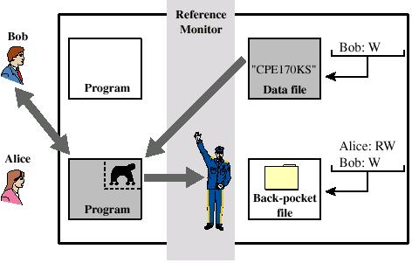
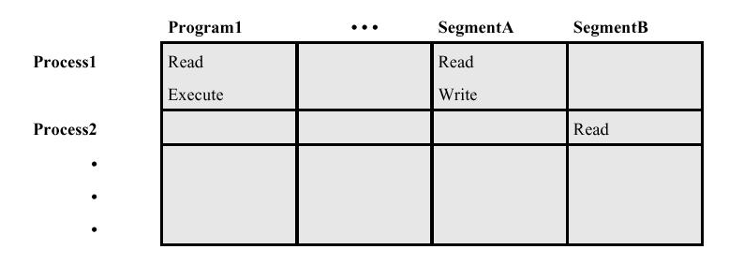

Security Techniques/ Access Control and Firewall
Firewall
Defense Policy
Access Control
Notes:
1

Slide 2
Security Techniques/ Access Control and Firewall
Access Control
is the practice of restricting access to resources only to authorized users, processes, or systems
Used to identify a user to a system
Associated with each user, there can be a profile that specifies permissible operations and accesses (authorization)
The operating system can enforce rules based on user profile

Slide 3
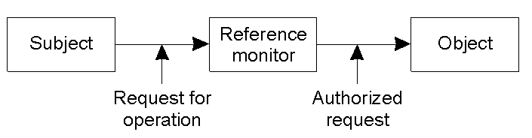
Security Techniques/ Access Control
Access Control: Generalized View
Access control: Verifying access rights to prevent misuse of resources
Authorization: Granting access rights
Notes:
3

Slide 4
Security Techniques/ Access Control
Access Control Model
General access control model
Access Control Matrix (ACM)
Access Control List (ACL)
Capability List (CL)
Basic elements of ACM
Subject: An entity capable of accessing objects, the concept of subject equates with that of process
Object: Anything to which access is controlled (files, programs, memory segments, …)
Access right: The way in which an object is accessed by a subject (read, write, execute, …)
Notes:
4

Slide 5
Security Techniques/ Access Control
Access Control Matrix
Object
Subject
Notes:
5

Slide 6
Security Techniques/ Access Control
Access Control Matrix
In the ACM, each subject is represented by a row and each object as a column
ACM [s, o] lists precisely which operations subject s can request to be carried out on object o
The drawback of this system is that the Matrix will have many empty entries
Another widely used approach is to use Access Control Lists in which each object maintains a list of access rights of subjects
Another approach is to give each subject a Capability List (access rights to objects) that are digitally signed
Notes:
6

Slide 7
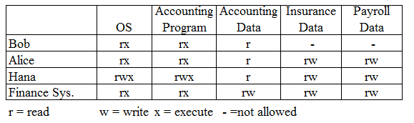
Security Techniques/ Access Control
Access Control Matrix - Example
Subject (Row): Three users (Bob, Alice, and Hana) and one program (Finance Sys.)
Object (Column):Five objects (OS, accounting Program, Accounting Data, Insurance Data, and Payroll Data)
Access Rights (each cell): Read, Write, Execute, Not Allowed)
Notes:
7

Slide 8
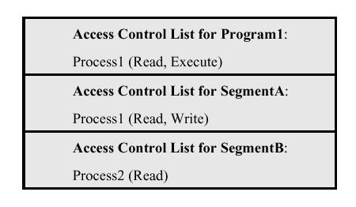
Security Techniques/ Access Control
Access Control List
Decomposition of the matrix by columns
An access control list of an object lists users and their permitted access right on the object
The list may contain a default or public entry
Notes:
8

Slide 9
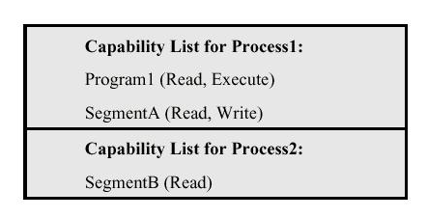
Security Techniques/ Access Control
Capability List
Decomposition of the matrix by rows
A capability ticket of a user specifies authorized objects and operations for a user
Each user has a number of such tickets
Notes:
9

Slide 10
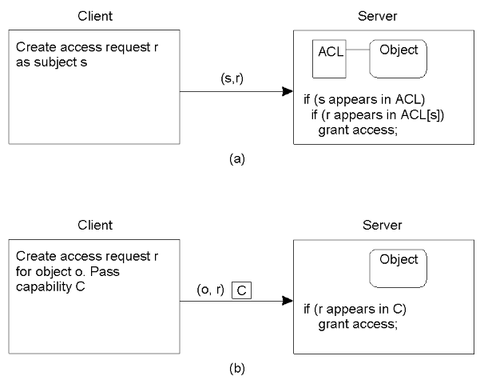
Security Techniques/ Access Control
Access Control List (a) Verses Capability List (b)
Notes:
10

Slide 11
Security Techniques/ Access Control
Protection Domain
An Access Control List or a Capability List can still become too large
One way of reducing ACLs is to make use of protection domains
A protection domain is a set of (object, access rights)
Requests for carrying out an operation are always issued within a domain
A user should be a member of a domain that has the required access rights to invoke an object
Notes:
11

Slide 12
Security Techniques/ Access Control
Multilevel Security
Multilevel security (E.g.. Military)
Protection of data and resources on the basis of levels of security
Users can be granted access to certain categories of data based on their level in their community (commanders, generals, …)
A multilevel secure system must enforce security policies like:
No read up: A subject can only read an object of less or equal security level (Simple Security Property)
No write down: A subject can only write into an object of greater or equal security level (*-Property)
Notes:
12

Slide 13
Security Techniques/ Access Control
Trusted System: Reference Monitor (Implementing policies)
Reference Monitor
Controlling element in the hardware and operating system that regulates the access of subjects to objects on the basis of security parameters
The monitor has access to a security kernel database
The monitor enforces the security policies (no read up, no write down, etc.)
Notes:
13

Slide 14
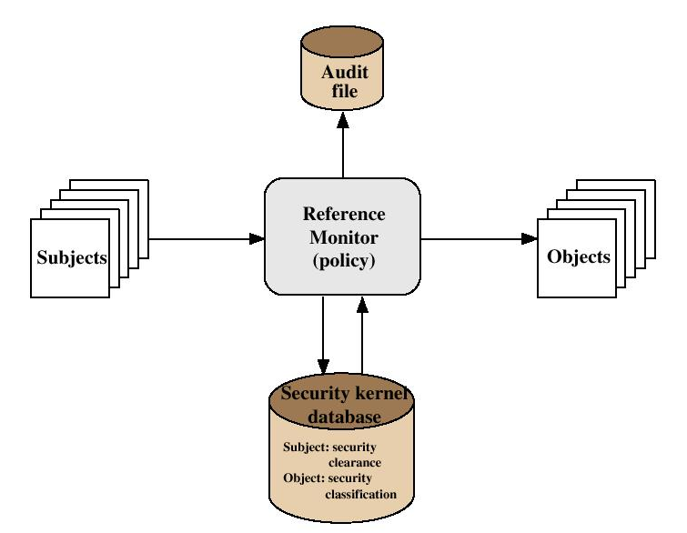
Security Techniques/ Access Control
Trusted System: Reference Monitor Concept
Notes:
14

Slide 15
Security Techniques/ Access Control
Trusted System: Reference Monitor Properties
Properties of the Reference Monitor
Complete mediation: Security rules are enforced on every access
Isolation: The reference monitor and its database themselves are protected from unauthorized modification
Verifiability: The reference monitor’s correctness must be provable
A system that can provide such verifications is referred to as a trusted system
Notes:
15

Slide 16
Security Techniques/ Access Control
Trojan Horse and Trusted Systems
Secure and trusted operating systems are one way to secure against Trojan Horse attacks on access control.
Trojan Horse is used to get around the standard security mechanism used by most file management and operating systems
Notes:
16

Slide 17
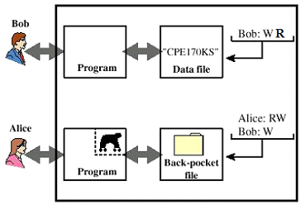
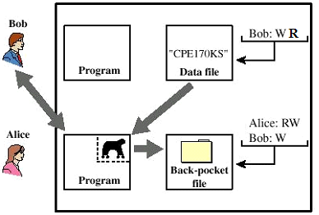
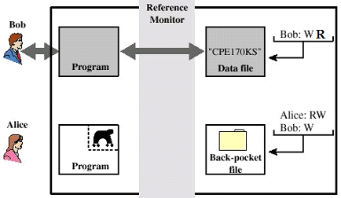
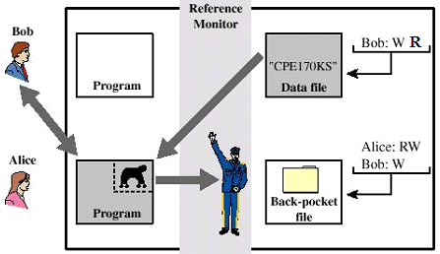
Security Techniques/ Access Control
Trojan Horse Attack: Bob with sensitive and Alice with public security levels
No Write Down Guard!
W. Stallings
Notes:
17

Slide 18
Security Techniques/ Access Control
Access Control Policies and Models
Security policy governs a set of rules and objectives needed by an organization.
A security model can be used by an organization to help express the policy or business rules to be used in a computer system.
Access control policies are high-level requirements that specify how access is managed and who may access information under what circumstances.
For instance, policies may pertain to resource usage within or across organizational units or may be based on need-to-know, competence, authority, or obligation.
There are two types of access control models:
Discretionary Access Control Model and
Non Discretionary Access Control Model
Notes:
18

Slide 19
Security Techniques/ Access Control
Access Control Policies
Discretionary Access Controls (DACs) is an access policy determined by the owner of an object. The owner decides who is allowed to access the object and with what privileges.
They are called discretionary as users can be given the ability of passing on their privileges of any of the objects under them to other users, without the intervention of the system administrator.
DAC requirements have been perceived as being technically correct for commercial and civilian government security needs, as well as for single-level military systems.
Non Discretionary Access Controls (NDACs) are controls that cannot be changed by users, but only through administrative action. NDAC has three popular forms of access control policies:
Mandatory Access Control (MAC),
Role-Based Access Control (RBAC) and
Temporal Authorization (TA).
Notes:
19

Slide 20
Security Techniques/ Access Control
Access Control Policies
Mandatory Access Control (MAC) is a means of restricting access to objects based on the sensitivity of the information contained in the objects and the formal authorization of subjects to access information of such sensitivity.
In MAC, decisions are made by a central authority, not by the individual owner of an object, and the owner cannot change access rights.
An example of MAC occurs in military security, where an individual data owner does not decide who has a Top Secret clearance, nor can the owner change the classification of an object from Top Secret to Secret.
Role-Based Access Control (RBAC) bases access control decisions on the functions/roles of a user that he/she is allowed to perform within an organization.
This includes the specification of duties, responsibilities, and qualifications. For example, the role “individual associated with a hospital” can include doctor, nurse and patient.
In RBAC policy, the users cannot pass access permissions on to other users at their discretion.
Temporal Authorization are formal statements of access policies that involve time-based access restrictions.
Notes:
20

Slide 21
Security Techniques/ Access Control
Multilevel Security Models
Multilevel security
Military-style classifications.
Subjects and objects are often partitioned into different security levels.
Protection is based on levels of security.
A subject can only access objects at certain levels determined by its security level and model in use.
A multilevel Security Models
Bell-LaPadula Model
Biba Integrity Model
Notes:
21

Slide 22
Security Techniques/ Access Control
Bell-LaPadula Model
Bell-LaPadula (BLP) model is one of the first multilevel security models that was created to control access to data.
For instance, if we have two levels of security namely unclassified and top secret:
Unclassified personnel cannot read data at top-Secret levels and
Top-Secret data cannot be written into files at unclassified levels.
Notes:
22

Slide 23
Security Techniques/ Access Control
Bell-LaPadula Model …
The two basic properties of the Bell-LaPadula model are:
“no read up” : A subject can only read an object of less or equal security level (Simple Security Property)
“no write down”: A subject can only write into an object of greater or equal security level (*-Property) or (Star Property)
Notes:
23

Slide 24
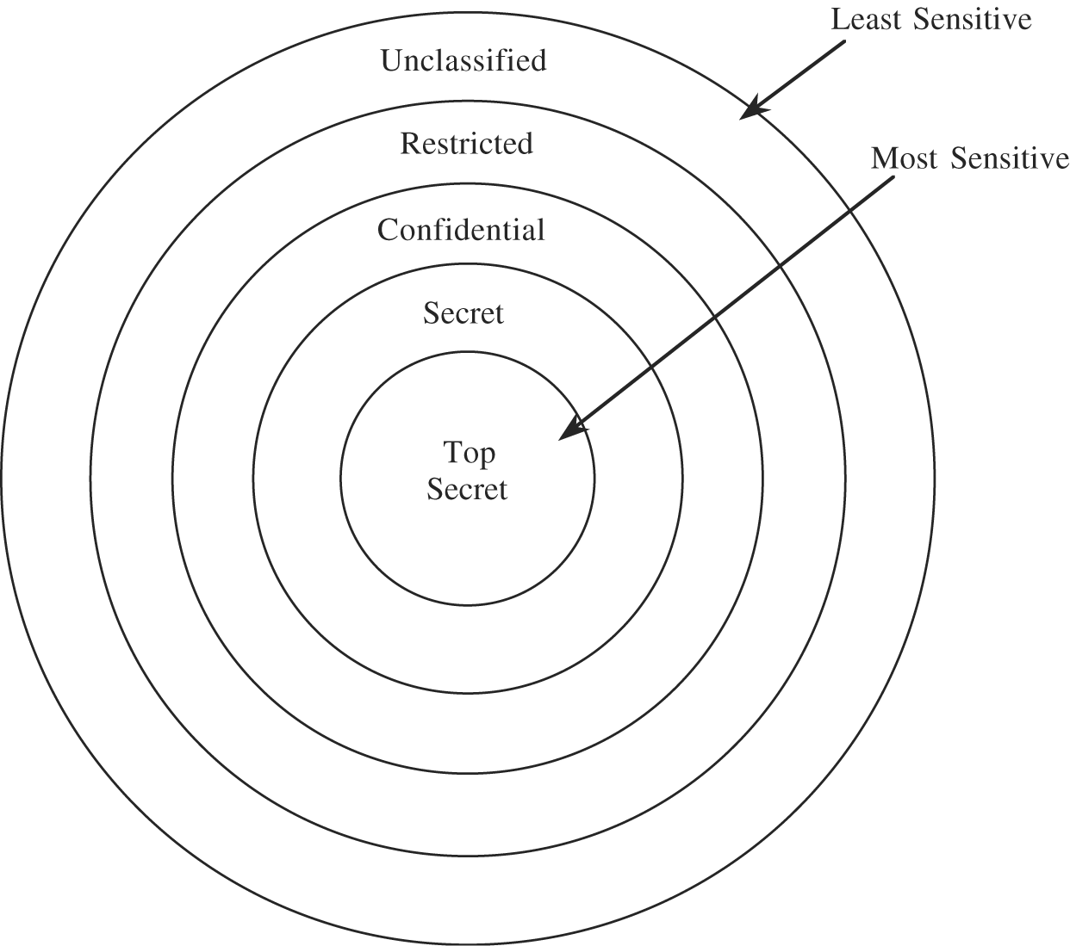
Security Techniques/ Access Control
Bell-LaPadula Model …
Hierarchy of Sensitivity
Notes:
24

Slide 25
Security Techniques/ Access Control
Bell-LaPadula Model
Examples of security classification:
security level
subject
object
Top Secret
Registrar
Grade Files
Secret
Teacher
Assignment Solutions
Confidential
Students
Assignments
Unclassified
Everyone
Syllabus
Security level Individuals Documents
Top Secret Thomas, Taye Personnel Files
Secret Sally, Samuel Electronic Mails
Confidential Claire, Chaltu Activity Log Files
Restricted Rim, Roman Email Address List
Unclassified Ubang, Umer Telephone Lists
Notes:
25

Slide 26
Security Techniques/ Access Control
Bell-LaPadula Model
The Bell-LaPadula model supports mandatory access control by determining the access rights from the security levels associated with subjects and objects.
It also supports discretionary access control by checking access rights from an access matrix.
With respect to specification, we can consider the multilevel model as adding higher-level mechanisms to the access matrix model.
In addition to supporting arbitrary access specifications to the access matrix, the model groups protected objects according to different security levels and decides user privileges by their authorized security clearance levels.
Notes:
26

Slide 27
Security Techniques/ Access Control
Bell-LaPadula Model
Thus, an access request (subj, obj, acc) is granted if and only if all of the following properties are satisfied:
simple security property (no read up): if acc is read, then level(subj) should dominate (greater than or equal to) level(obj)
*-property (no write down): if acc is append, then level(obj) should dominate level(subj);
discretionary security property: the (subj, obj) cell in the matrix contains acc
Notes:
27

Slide 28
Security Techniques/ Access Control
Biba Integrity Model
A problem with BLP model is, it does not deal with the integrity of data as the *-property makes it possible for a lower level subject to write to a higher classified object
The inability of the BLP model to deal with integrity of data motivated creation of the Biba model
The Biba integrity model was published in 1977 at the Mitre Corporation, one year after the Bell La-Padula model was published.
The Biba model addresses the problem with the *-property of the Bell-LaPadula model, which does not restrict a subject from writing to a more trusted object
Notes:
28

Slide 29
Security Techniques/ Access Control
Biba Integrity Model – Access Modes
The Biba model consists of the following access modes:
Modify: the modify right allows a subject to write to an object. This mode is similar to the write mode in other models.
Observe: the observe right allows a subject to read an object. This command is synonyms with the read command of most other models.
Invoke: the invoke right allows a subject to communicate with another subject.
Execute: the execute right allows a subject to execute an object. The command essentially allows a subject to execute a program which is the object.
Notes:
29

Slide 30
Security Techniques/ Access Control
Biba Integrity Model - Policies
The Biba model is a family of different policies
The goal of the model is to prevent the contamination of “clean” high level entities from “dirty” low level entities.
The model supports both mandatory and discretionary policies
Notes:
30

Slide 31
Security Techniques/ Access Control
Biba Integrity Model – Policies …
Biba Strict Integrity Policy consists of:
Simple Integrity Property: s ∈ S can observe o∈ O if and only if i(s) ≤ i(o) (“no read-down”).
Integrity Star Property: s ∈ S can modify o∈ O if and only if i(o) ≤ i(s) (“no write-up”).
Invocation Property: s₁ ∈ S can invoke s₂ ∈ S if and only if i(s₂) ≤ i(s₁) (“no upward invocation”).
Notes:
31

Slide 32
Security Techniques/ Access Control
Biba Integrity Model – Policies …
Simple Integrity Property:“No Read-Down”
circle = subject, square = object
circle = subject, square = object
Notes:
32

Slide 33
Security Techniques/ Access Control
Biba Integrity Model – Policies …
Integrity Star Property: “No Write-Up”
circle = subject, square = object
Notes:
33

Slide 34
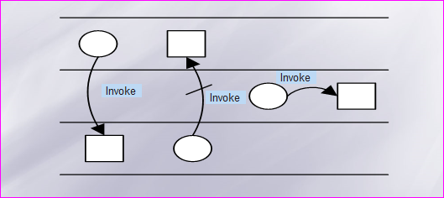
Security Techniques/ Access Control
Biba Integrity Model – Policies …
Invocation Property: “No upward invocation”
circle = subject, square = object
Notes:
34

Slide 35
Security Techniques/ Access Control
Biba Integrity Model – Policies …
The Biba strict integrity policy enforces “no write-up” and “no read-down” on the data in the system, which is the opposite of the Bell-LaPadula model.
This policy restricts the “contamination” of data at higher level, since a subject is only allowed to modify data at their level or at a lower level.
The “no write-up” limits the damage that can be done by malicious programs in the system.
For instance, “no write-up” limits the amount of damage that can be done by a Trojan Horse in the system. The Trojan horse would only be able to write to objects at its integrity level or lower. This is important because it limits the damage that can be done to the operating system.
The “no read-down” prevents a trusted subject from being “contaminated” by a less trusted object.
Notes:
35

Slide 36
Security Techniques/ Access Control
Biba Integrity Model – Policies … ... non-strict
The low-watermark policy for subjects is a relaxed “no read-down”.
The low-watermark policy for subjects contains these following rules:
Integrity Star Property: s ∈ S can modify o∈ O if and only if i(o) ≤ i(s) (“no write-up”).
A subject may examine any object. If s ∈ S examines o ∈ O then i′(s) = min(i(s),i(o)), where i′(s) is the subjects integrity level after the read.
Invocation Property: s₁∈ S can invoke s₂ ∈ S if and only if i(s₂) ≤ i(s₁).
Notes:
36

Slide 37
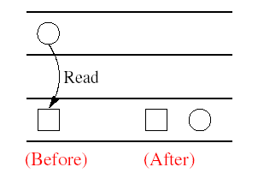
Security Techniques/ Access Control
Biba Integrity Model – Policies …
Low-Watermark Policy for Subjects
circle = subject, square = object
Notes:
37

Slide 38
Security Techniques/ Access Control
Biba Integrity Model – Policies …
The low-watermark policy for subjects does nothing to restrict a subject from reading objects.
The low-watermark policy for subjects is a dynamic policy, because it lowers the integrity level of a subject based on what objects are observed.
One problem with this policy is that if a subject observes a less trusted object, it will drop the subjects integrity level to that of the object. Then later, if the subject needs to legitimately observe other objects, it may not be able to do so because the subjects integrity level has been lowered. The effect of this would be denial of service depending on the timing of the submissions.
Notes:
38

Slide 39
Security Techniques/ Access Control
Biba Integrity Model – Policies …
The low-watermark policy for objects is a relaxed “no write-down”.
The following rules make up the low-watermark for objects policy:
s ∈ S can modify any o ∈ O regardless of integrity level.
If s ∈ S modifies o ∈ O then i′(o) = min(i(s),i(o)), where i′(o) is the objects integrity level after it is modified.
Notes:
39

Slide 40
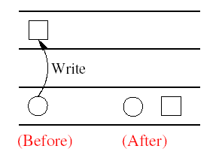
Security Techniques/ Access Control
Biba Integrity Model – Policies …
Low-Watermark Policy for Objects
circle = subject, square = object
Notes:
40

Slide 41
Security Techniques/ Access Control
Biba Integrity Model – Policies …
The low-watermark policy for objects is also a dynamic policy, similar to the low-watermark policy for subjects.
The disadvantage of this policy is it does nothing to prevent an untrusted subject from modify a trusted object. In reality policy is not very practical.
The policy provides no real protection in a system.
The policy simply lowers in the trust placed in the objects. If a malicious program was inserted into the computer system it could modify any object in the system.
This model would just lower the integrity level of objects that have become contaminated.
Notes:
41

Slide 42
Security Techniques/ Access Control
Biba Integrity Model – Policies …
The low-watermark integrity audit policy consists of the following rules:
Any subject may modify any object, regardless of integrity levels.
If a subject modifies an object at higher integrity level (a more trusted object), it results in the transaction being recorded in an audit log.
The drawback to this policy is it does nothing to prevent an improper modifications of an object. This policy is similar to the low-watermark for objects policy, except in this case the objects integrity level is not lowered, it is recorded.
This policy simply records that an improper modification took place.
Notes:
42

Slide 43
Security Techniques/ Access Control
Biba Integrity Model – Policies ...
The ring policy is the last mandatory policy in the Biba model
The Ring Policy consists of the following rules:
Any subject can observe any object, regardless of integrity levels.
Integrity Star Property: s ∈ S can modify o∈ O if and only if i(o) ≤ i(s) (“no write up”).
Invocation Property: s₁ ∈ S can invoke s₂ ∈ S if and only if i(s₂) ≤ i(s₁).
The Ring Policy allows any subject to observe any object. This policy is only concerned with direct modification
The drawback to this policy is it allows improper modifications to indirectly take place.
A subject can read a less trusted object. Then the subject could modify the data it observed at its own integrity level.
An example of this would be a user reading a less trusted object, then remember the data that they read and then at a later time writing that data to an object at their own integrity level.
Notes:
43

Slide 44
Security Techniques/ Access Control
Biba Integrity Model - Conclusion
The Biba model is a family of different models that can be selected
The model should be combined with another model, because it does not provide confidentiality. A model such as the Bell-LaPadula should be used to complement it
Read about:
Clark-Wilson Model
Chinese Wall Model
Lipner Model
Notes:
44

Slide 45
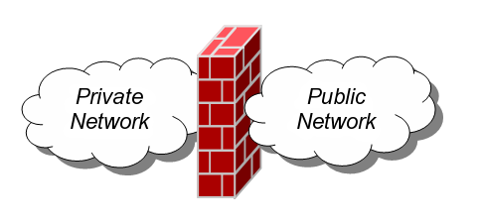
Security Techniques/ Firewall
Notes:
45

Slide 46
Security Techniques/Firewall
What is Firewall?
The term firewall has been around for quite some time and originally was used to define a barrier constructed to prevent the spread of fire from one part of a building or structure to another.
Network firewalls provide a barrier between networks that prevents or denies unwanted or unauthorized traffic.
Definition: A Network Firewall is a system or group of systems used to control access between two networks: a trusted network and an untrusted network, using pre-configured rules or filters.
Device that provides secure connectivity between networks (internal/external; varying levels of trust)
Used to implement and enforce a security policy for communication between networks
Firewalls can either be hardware and/or software based.

Slide 47
Security Techniques/Firewall
What is Firewall? …
Firewalls can be composed of a single router, multiple routers, a single host system or multiple hosts running firewall software, hardware appliances specifically designed to provide firewall services, or any combination thereof.
They vary greatly in design, functionality, architecture, and cost.
A firewall is also called a Border Protection Device (BPD) in certain military contexts where a firewall separates networks by creating perimeter networks in a DMZ “Demilitarized Zone”.
DMZ is a sub network that contains organizations external facing services like Web services, Mail services, FTP Services, VoIP services etc.

Slide 48
Security Techniques/Firewall
Firewall History
Firewall technology emerged in the late 1980s when the Internet was a fairly new technology in terms of its global use and connectivity. The original idea was formed in response to a number of major internet security breaches, which occurred in the late 1980s.
First generation - packet filters
The first paper published on firewall technology was in 1988, when Jeff Mogul from Digital Equipment Corporation (DEC) developed filter systems known as packet filter firewalls.
Second generation - circuit level
From 1980-1990 two colleagues from AT&T Company, developed the second generation of firewalls known as circuit level firewalls.
Third generation - application layer
Publications by Gene Spafford of Purdue University, Bill Cheswick at AT&T Laboratories described a third generation firewall. also known as proxy based firewalls.

Slide 49
Security Techniques/Firewall
Firewall Overview
It is more feasible to secure a community of users by putting some control at the entrance rather than trying to secure every host
This is done in the real world
Countries protect themselves at their borders
Neighborhoods protect the whole neighbors
A firewall acts to provide secured access between two networks
A firewall may be implemented as a standalone hardware device or in the form of a software
Notes:
49

Slide 50
Security Techniques/Firewall
Firewall Overview …
The simplest kind of Firewall is a packet filter.
A packet filter is a router that is augmented with an access control list, usually specified as a list of rules.
When any packet is received by the router, the security rules are consulted to decide whether the packet should be forwarded or dropped (ALLOW or DROP).
A rule can specify which packets it will apply to, based on the header fields of the packets. For instance, the rule might specify source and destination IP addresses and port numbers and protocol names, or wild cards for each of these.
Notes:
50

Slide 51
Security Techniques/Firewall
Firewall Overview …
Suppose that we've built a security policy and decided that we want to:
allow inbound tcp connections to port 25 of mail server (1.2.3.4):
Allow tcp *:* → 1.2.3.4:25
allow all outbound tcp connections:
Allow tcp {ourhosts}:* →*:*
drop all the rest:
Drop *:* → *:*
Notes:
51

Slide 52
Security Techniques/Firewall
Firewall Design goals
All traffic from outside to inside must pass through the firewall (physically blocking all access to the local network except via the firewall)
Only authorized traffic (defined by the local security policy) will be allowed to pass
The firewall itself is immune to penetration (use of trusted system with a secure operating system)
Notes:
52

Slide 53
Security Techniques/Firewall
Firewall Features
General
Port Control
Network Address Translation
Application Monitoring
Packet Filtering
Data encryption
Logging
E-mail virus protection
Popup advertisement blocking
Spyware protection
Notes:
53

Slide 54
Security Techniques/Firewall
Hardware Firewall
Use one or more of three methods
Packet filtering
Proxy service
State-full inspection
It protects from
Remote logins
Application backdoors
SMTP session hijacking
Spam
Denial of service
E-mail bombs
Notes:
54

Slide 55
Security Techniques/Firewall
Software Firewall
It is a firewall that operate at the Application Layer of OSI
Benefits
Easier to track when a potential vulnerability happens
Protect against new vulnerabilities before they are found and exploited
Ability to "understand" application specific information structure
Incoming or outgoing packets cannot access services for which there is no proxy
Disadvantages
Slows down network access dramatically
More susceptible to distributed denial of service (DDOS) attacks
Not transparent to end users
Require manual configuration of each client computer
Notes:
55

Slide 56
Security Techniques/Firewall
How Firewalls Work
There are two security design logic approaches network firewalls use to make access control decisions.
Deny all: Everything, not specifically permitted, is denied.
Allow all: Everything, not specifically denied, is permitted.
The one most often recommended is everything not specifically permitted is denied (deny all)

Slide 57
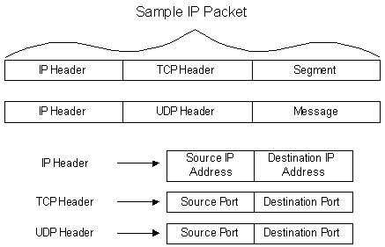
Security Techniques/Firewall
Basic TCP/IP Flow Review

Slide 58
Security Techniques/ Firewall
Types of Firewalls

Slide 59
Security Techniques/ Firewall
Types of Firewalls …
1. By the Firewalls methodology :
Packet Filtering
Stateful Packet Inspection
Application Gateways/Proxies
Adaptive Proxies
Circuit Level Gateway

Slide 60
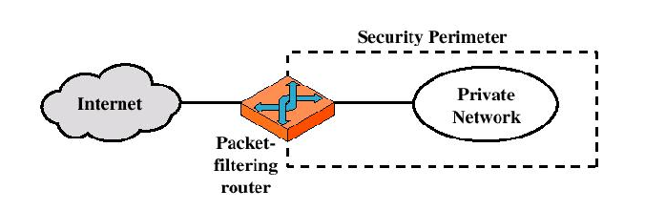
Security Techniques/Firewall
Packet-filtering firewall

Slide 61
Security Techniques/ Firewall
Packet Filtering Firewall
A packet filtering firewall does exactly what its name implies (it filters packets).
As each packet passes through the firewall, it is examined and information contained in the header is compared to a pre-configured set of rules or filters.
An allow or deny decision is made based on the results of the comparison.
Each packet is examined individually regardless to other packets that are part of the same connection.

Slide 62
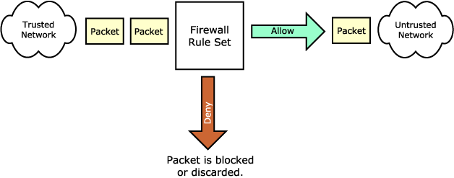
Security Techniques/ Firewall
Packet Filtering Firewall …
Untrusted Network
Firewall rule set
Trusted Network
Packet is Blocked or Discarded

Slide 63
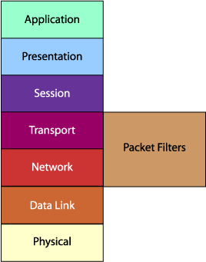
Security Techniques/ Firewall
Packet Filtering Firewall …
A packet filtering firewall is often called a network layer firewall because the filtering is primarily done at the network layer (layer three) or the transport layer (layer four) of the OSI reference model.

Slide 64
Security Techniques/ Firewall
Packet Filtering Firewall …
You use packet filters to instruct a firewall to drop traffic that meets certain criteria.
For example, you could create a filter that would drop all ping requests.
You can also configure filters with more complex exceptions to a rule.
Notes:
64

Slide 65
Security Techniques/ Firewall
Packet Filtering Firewall …
Packet filtering rules or filters can be configured to allow or deny traffic based on one or more of the following variables:
Source IP address
Destination IP address
Protocol type (TCP/UDP)
Source port
Destination port

Slide 66
Security Techniques/Firewall
Packet Filtering Firewall …
Advantages:
Simplicity
Transparency to users
High speed
Disadvantages:
Difficulty of setting up packet filter rules
Lack of Authentication

Slide 67
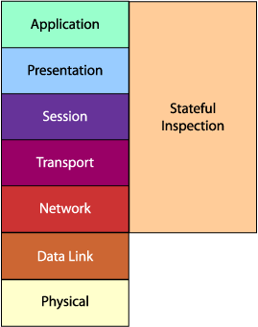
Security Techniques/ Firewall
Stateful Packet Inspection …
Stateful packet inspection uses the same fundamental packet screening technique that packet filtering does.
In addition, it examines the packet header information from the network layer of the OSI model to the application layer to verify that the packet is part of a legitimate connection and the protocols are behaving as expected.

Slide 68
Security Techniques/ Firewall
Stateful Packet Inspection …
As packets pass through the firewall, packet header information is examined and fed into a dynamic state table where it is stored. The packets are compared to pre-configured rules or filters and allow or deny decisions are made based on the results of the comparison.
The data in the state table is then used to evaluate subsequent packets to verify that they are part of the same connection.

Slide 69
Security Techniques/ Firewall
Stateful Packet Inspection …
This method can make decisions based on one or more of the following:
Source IP address
Destination IP address
Protocol type (TCP/UDP)
Source port
Destination port
Connection state

Slide 70
Security Techniques/ Firewall
Stateful Packet Inspection …
The connection state is derived from information gathered in previous packets.
It is an essential factor in making the decision for new communication attempts.
Stateful packet inspection compares the packets against the rules or filters and then checks the dynamic state table to verify that the packets are part of a valid, established connection.
By having the ability to "remember" the status of a connection, this method of packet screening is better equipped to guard against attacks than standard packet filtering.

Slide 71
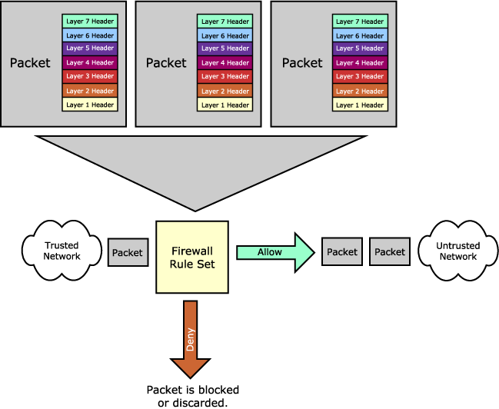
Security Techniques/ Firewall
Stateful Packet Inspection …
Trusted
Network
Untrusted Network
Packet is Blocked or Discarded

Slide 72
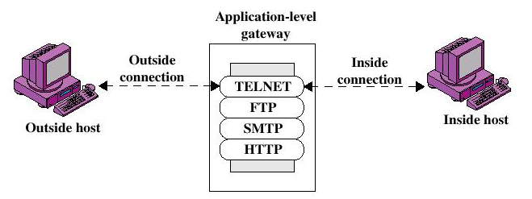
Security Techniques/Firewall
Application-level Gateway/Proxies
Also called proxy server
Acts as a relay of application-level traffic

Slide 73
Security Techniques/Firewall
Application-level Gateway/ Proxies
Advantages:
Higher security than packet filters
Only need to scrutinize a few allowable applications
Easy to log and audit all incoming traffic
Disadvantages:
Additional processing overhead on each connection (gateway as splice point)
Notes:
73

Slide 74
Security Techniques/ Firewall
Application Level Gateways/Proxies
The proxy plays middleman in all connection attempts.
The application gateway/proxy acts as an intermediary between the two endpoints.
This packet screening method actually breaks the client/server model in that two connections are required: one from the source to the gateway/proxy and one from the gateway/proxy to the destination.
Each endpoint can only communicate with the other by going through the gateway/proxy.

Slide 75
Security Techniques/ Firewall
Application Gateways/Proxies …
This type of firewall operates at the application level of the OSI model. For source and destination endpoints to be able to communicate with each other, a proxy service must be implemented for each application protocol.
The gateways/proxies are carefully designed to be reliable and secure because they are the only connection point between the two networks.

Slide 76
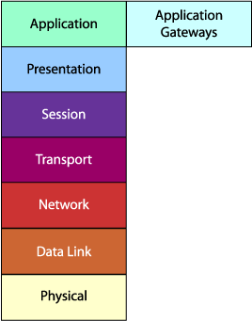
Security Techniques/ Firewall
Application Gateways/Proxies …

Slide 77

Security Techniques/ Firewall
Application Gateways/Proxies …
When a client issues a request from the untrusted network, a connection is established with the application gateway/proxy.
The proxy determines if the request is valid (by comparing it to any rules or filters) and then sends a new request on behalf of the client to the destination.
By using this method, a direct connection is never made from the trusted network to the untrusted network and the request appears to have originated from the application gateway/proxy.
Application Gateway (Proxy service)
Untrusted Network
Work Station

Slide 78
Security Techniques/ Firewall
Application Gateways/Proxies …
The response is sent back to the application gateway/proxy, which determines if it is valid and then sends it on to the client.
By breaking the client/server model, this type of firewall can effectively hide the trusted network from the untrusted network.
It is important to note that the application gateway/proxy actually builds a new request, only copying known acceptable commands before sending it on to the destination.
Unlike packet filtering and stateful packet inspection, an application gateway/proxy can see all aspects of the application layer so it can look for more specific pieces of information.

Slide 79
Security Techniques/ Firewall
Adaptive Proxies
Known as dynamic proxies
Developed as an enhanced form of application gateways/proxies. Combining the merits of both application gateways/proxies and packet filtering

Slide 80
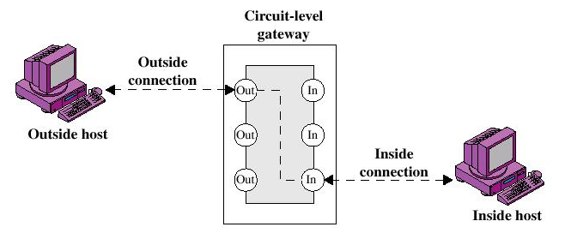
Security Techniques/Firewall
Circuit-level Gateway

Slide 81
Security Techniques/Firewall
Circuit-level Gateway …
Circuit-level Gateway
Host based system or
Specialized function performed by an Application-level Gateway
Sets up two TCP connections
The gateway typically relays TCP segments from one connection to the other
The security function consists of determining which connections will be allowed

Slide 82
Security Techniques/ Firewall
Circuit-level Gateway …
Unlike a packet filtering firewall, a circuit-level gateway does not examine individual packets. Instead, circuit-level gateways monitor TCP or UDP sessions.
Once a session has been established, it leaves the port open to allow all other packets belonging to that session to pass. The port is closed when the session is terminated.
Circuit-level gateways operate at the transport layer (layer 4) of the OSI model.

Slide 83
Security Techniques/ Firewall
Types of Firewalls
2. With regard to the scope of filtered communications
Done between a single node and the network, or between two or more networks.
Personal Firewalls, a software application which normally filters traffic entering or leaving a single computer.
Network firewalls, normally running on a dedicated network device or computer positioned on the boundary of two or more networks.

Slide 84
Security Techniques/ Firewall
Types of Firewalls
3. Whether the firewalls keeps track of the state of network connections or treats each packet in isolation:
Stateful firewall
Stateless firewall

Slide 85
Security Techniques/ Firewall
Types of Firewalls …
Stateful firewall
Keeps track of the state of network connections (such as TCP streams) traveling across it.
Stateful firewall is able to hold in memory significant attributes of each connection, from start to finish.
These attributes, which are collectively known as the state of the connection, may include such details as the IP addresses and ports involved in the connection and the sequence numbers of the packets traversing the connection.

Slide 86
Security Techniques/ Firewall
Types of Firewalls …
Stateless firewall
Treats each network frame (Packet) in isolation. Such a firewall has no way of knowing if any given packet is part of an existing connection or is trying to establish a new connection.
The classic example is the File Transfer Protocol, because by design it opens new connections to random ports.

Slide 87
Security Techniques/Firewall
Firewall Topologies
In addition to the use of simple configuration of a single system (single packet filtering router or single gateway), more complex configurations are possible
Common firewall Topologies/Configurations
Single-homed bastion host
Dual-homed bastion host
Screened-subnet firewall system

Slide 88
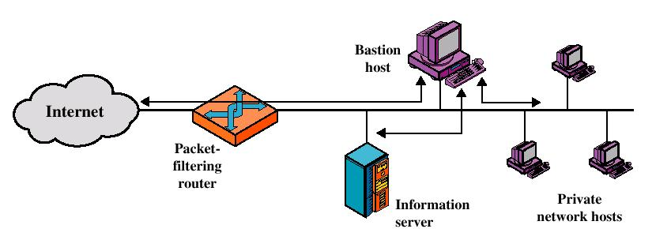
Security Techniques/Firewall
1. Screened host firewall system (single-homed bastion host)

Slide 89
Security Techniques/Firewall
Screened host firewall, single-homed bastion configuration
Firewall consists of two systems:
A packet-filtering router
A bastion host

Slide 90
Security Techniques/Firewall
Configuration for the packet-filtering router:
Only packets from and to the bastion host are allowed to pass through the router
The bastion host performs authentication and proxy functions

Slide 91
Security Techniques/Firewall
Greater security than single configurations because of two reasons:
This configuration implements both packet-level and application-level filtering (allowing for flexibility in defining security policy)
An intruder must generally penetrate two separate systems

Slide 92
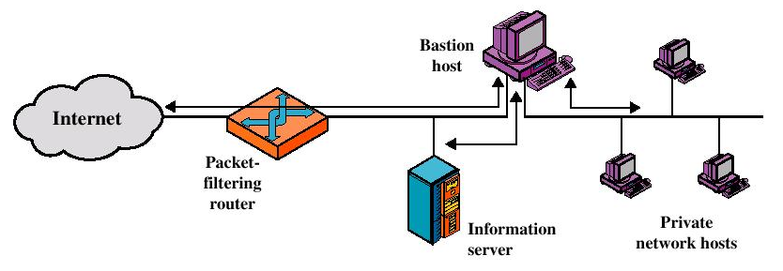
Security Techniques/Firewall
2. Screened host firewall system (dual-homed bastion host)

Slide 93
Security Techniques/Firewall
Screened host firewall, dual-homed bastion configuration
The packet-filtering router is not completely compromised
Traffic between the Internet and other hosts on the private network has to flow through the bastion host

Slide 94
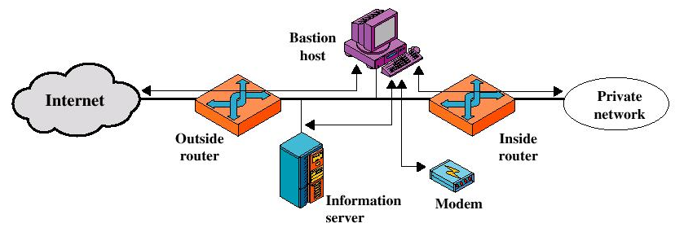
Security Techniques/Firewall
3. Screened-subnet or DMZ firewall

Slide 95
Security Techniques/Firewall
Screened-subnet or DMZ firewall …
Most secure configuration of the three
Creation of an isolated sub-network between two packet filtering routers.
The exterior router is the only connection between the enterprise network and the outside world
The interior router does the bulk of the access control work.
The bastion host is a secure server. It provides an interconnection point between the enterprise network and the outside world for the restricted services

Slide 96
Security Techniques/Firewall
Screened-subnet or DMZ firewall …
Advantages:
Three levels of defense to thwart intruders
The outside router advertises only the existence of the screened subnet to the Internet (internal network is invisible to the Internet)
The inside router advertises only the existence of the screened subnet to the internal network (the systems on the inside network cannot construct direct routes to the Internet)

Slide 97
Security Techniques/Firewall
Intrusion Detection (ID)
Firewalls generally don’t detect internal attacks or attacks once the system is compromised
An ID system gathers and analyzes information from various areas within a computer or a network to identify possible security breaches
It detects both intrusions and misuse
Notes:
97

Slide 98
Security Techniques/Firewall
Intrusion Detection (ID)…
Intrusion detection functions include
Monitoring and analyzing both user and system activities
Analyzing system configurations and vulnerabilities
Assessing system and file integrity
Ability to recognize patterns typical of attacks
Analysis of abnormal activity patterns
Tracking user policy violations
Notes:
98

Slide 99
Security Techniques/Firewall
Summary
Eliminate unnecessary services
Apply all patches
Public servers are vulnerable to attack
Use a DMZ to provide layered defence
Place proxy servers in DMZ
Place private data/file/servers in Intranet
Use default deny for Internet-Intranet traffic and apply other firewall rules like in the example below:
allow TCP *:* → <web server IP>:80
allow TCP *:* → <web server IP>:443
deny all
Add stateful inspection rules for known attacks (Code Red, Slammer, …)
Firewalls generally don’t detect internal attacks or attacks once the system is compromised
Notes:
99

